Slide 1
Multimodal Holographic Microscope
TESCAN
Brno University of Technology
Institute of Molecular Genetics

Slide 2
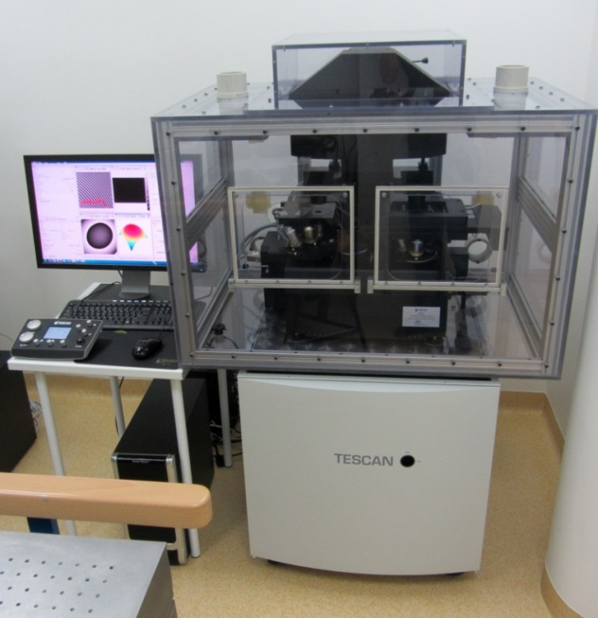
Multimodal Holographic Microscope
The successful cooperation between TESCAN, a.s., Brno University of Technology and Institute of Molecular Genetics leaded into the first prototype of Multimodal holographic microscope – the unique instrument using the incoherent holography for the quantitative phase imaging.
In comparison to well established techniques, the prototype enables:
Observation of living cells in their native environment (no staining)
Unique imaging properties – imaging in dispersion solutions,
high sensitivity, correlation with other imaging methods
Suited for biological and biotechnical applications
The worldwide unique technical solution is covered by EU, USA and EA
patents, patent pending in several other countries worldwide.
The first prototype is installed at Brno University of Technology, the second
one will be delivered to the Institute of Molecular Genetics, Prague.
Both machines are available to scientific public for any tests and applications.

Slide 3
The journey to the first prototype
The original idea to use incoherent holography as the basic principle for cells observations was introduced by the engineers from Brno University of Technology group leaded by Radim Chmelík in early nineties.
The long-term experiments were promising enough to be commercialized
Due to the well established cooperation between TESCAN company and BUT it had been natural to start a project for the system commercialization.
The official cooperation of TESCAN and BUT started in 2010. Since 2012, it is supported by public funding provided by Ministry of Industry and Trade (FR-TI4/660).
The commercial production is planned from the year 2015

Slide 4
Main persons involved
Radim Chmelík
Head of Deptartment of Optics and Precise Mechanics at IPE FME & of Experimental Biophotonics research group at CEITEC, Brno University of Technology
Key person for the R&D activities in the project
One of the authors of the technological idea used
One of the authors of the patents
Filip Lopour
R&D director in TESCAN company
Responsible for the system prototype development
Leading the R&D team in TESCAN
Pavel Hozák
Head of Department of Biology of the Cell Nucleus, Institute of Molecular genetics, Academy of Sciences of the Czech Republic
Design and testing of biological applications in holographic microscope
Correlative experiments
Tomáš Slabý
R&D Physics engineer in TESCAN
One of the authors of the technological idea and patents
Responsible for optical design of the microscope
For further information please contact : Zora Střelcová, Project Manager, zora.strelcova@tescan.cz

